Slide 1



Splash Screen

Slide 2
Lesson Menu
Five-Minute Check (over Lesson 3–4)
Then/Now
New Vocabulary
Key Concept: Adding Like Fractions
Example 1: Add Fractions
Example 2: Add Mixed Numbers
Key Concept: Subtracting Like Fractions
Example 3: Subtract Fractions
Example 4: Subtract Mixed Numbers with Regrouping
Example 5: Real-World Example: Subtract Mixed Numbers
Example 6: Add or Subtract Algebraic Fractions

Slide 3
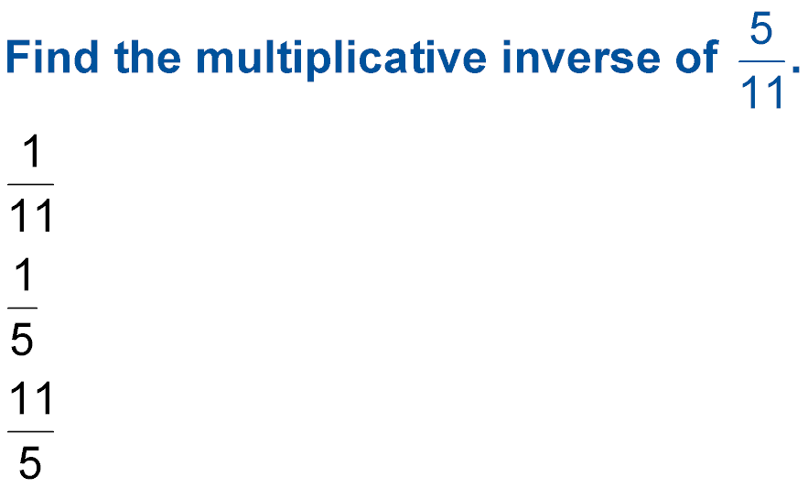

5-Minute Check 1
A.
B.
C.
D. 55

Slide 4
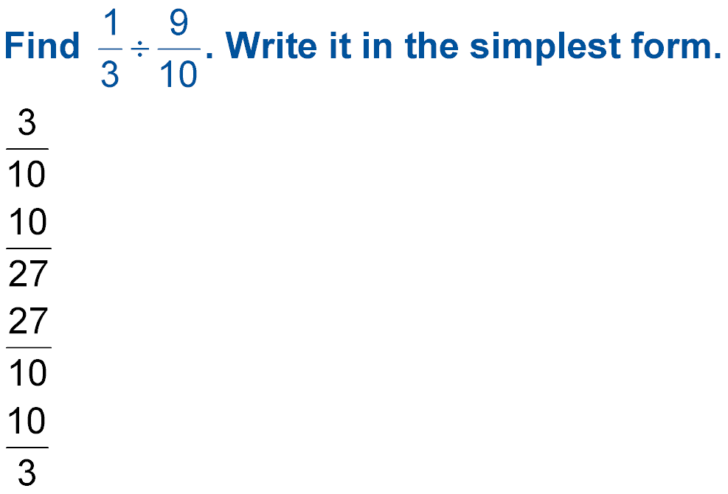

5-Minute Check 2
Write in simplest form.
A.
B.
C.
D.

Slide 5
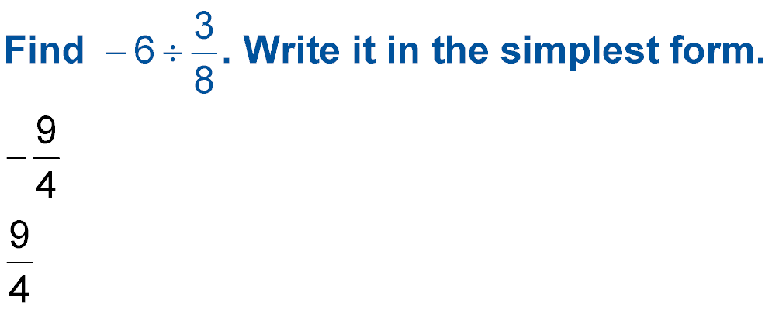

5-Minute Check 3
Write in simplest form.
A. –16
B.
C.
D. 16

Slide 6


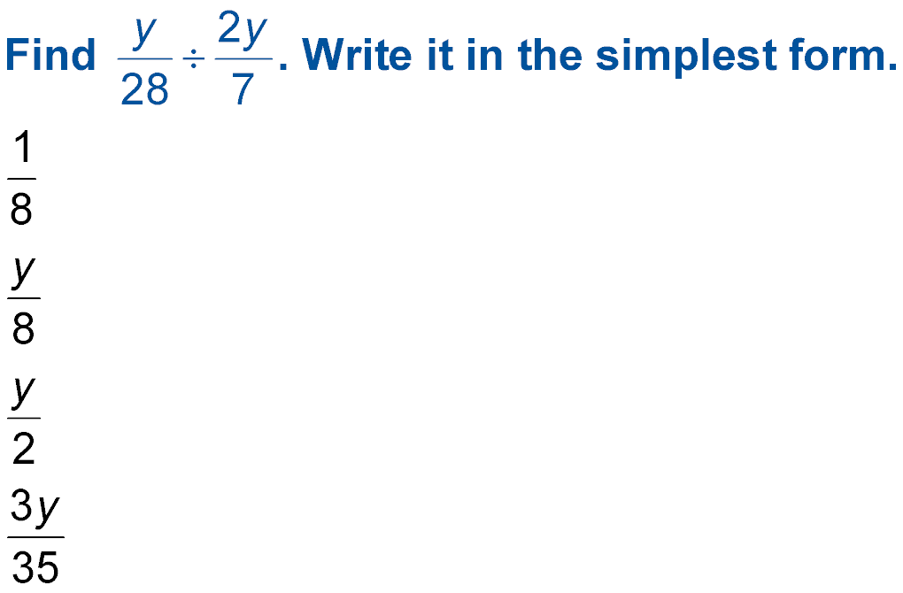
5-Minute Check 4
A.
B.
C.
D.

Slide 7
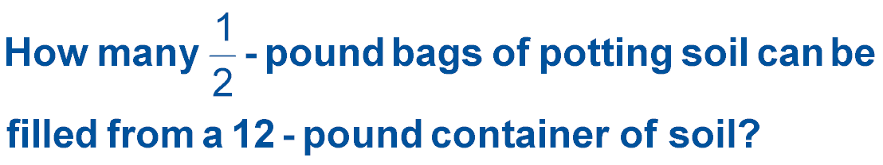

5-Minute Check 5
A. 6
B. 12
C. 18
D. 24

Slide 8

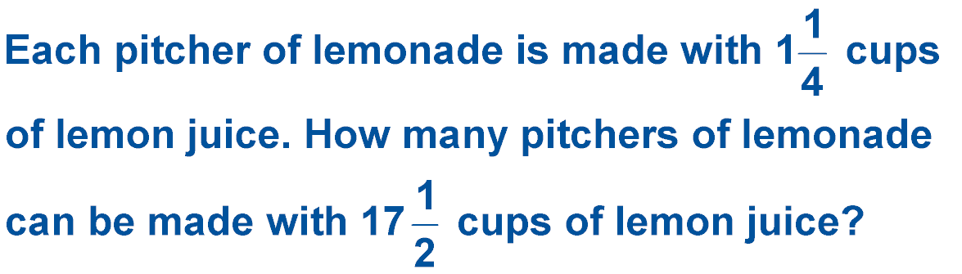
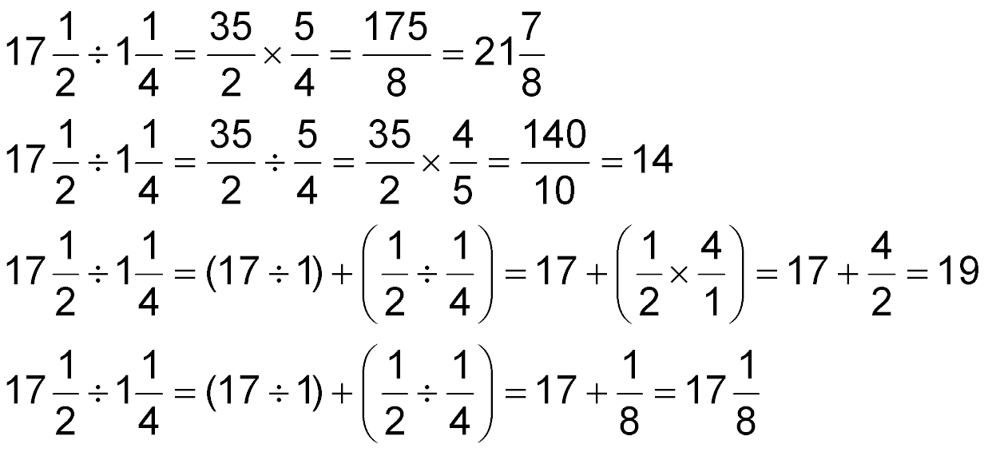
5-Minute Check 6
A.
B.
C.
D.

Slide 9


Then/Now
You have already added and subtracted positive fractions with like denominators. (Previous Course)
Add rational numbers with common denominators.
Subtract rational numbers with common denominators.

Slide 10

Vocabulary
like fractions

Slide 11
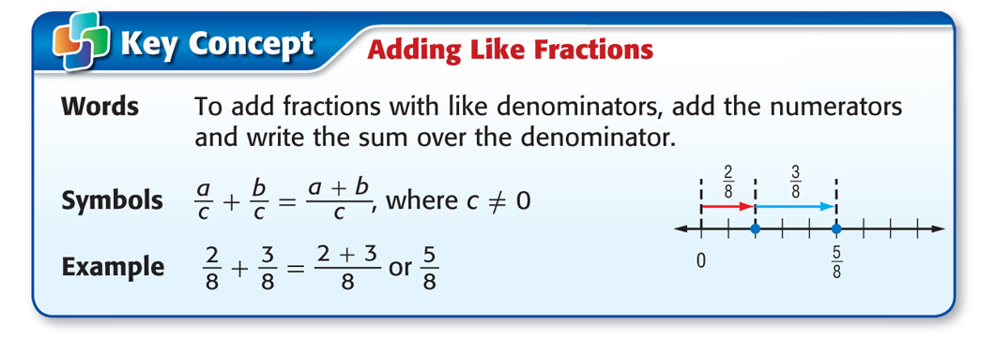
Concept

Slide 12

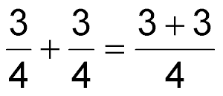
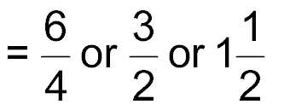
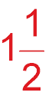
Example 1
Add Fractions
in simplest form.
A.
Estimate 1 + 1 = 2
The denominators are the same. Add the numerators.
Simplify and rename as a mixed number.
Answer:
Compared to the estimate, the answer is reasonable.

Slide 13

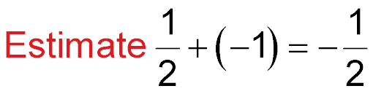
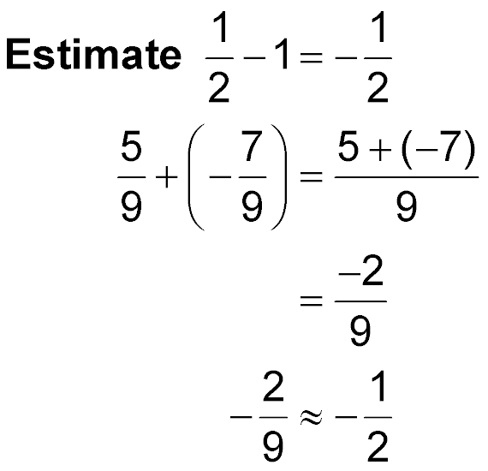
Example 1
Add Fractions
B.
The denominators are the same. Add the numerators.
Simplify.

Slide 14
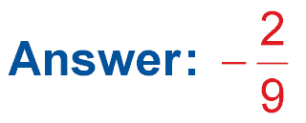
Example 1
Add Fractions
Check for Reasonableness
✓

Slide 15



Example 1
A.
A.
B.
C.
D.

Slide 16
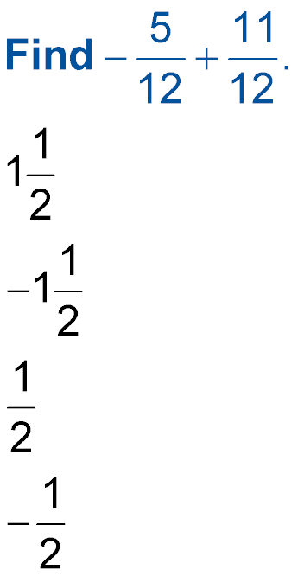
Example 1
Write in simplest form.
B.
A.
B.
C.
D.

Slide 17
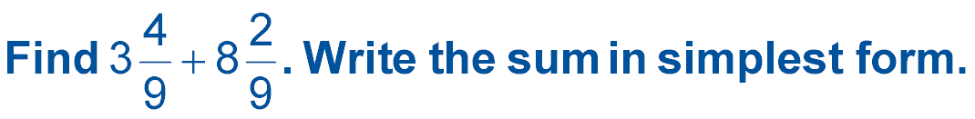
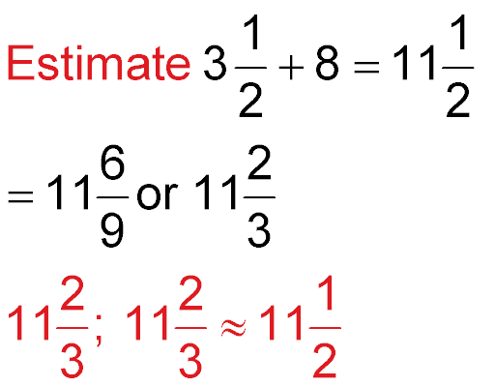
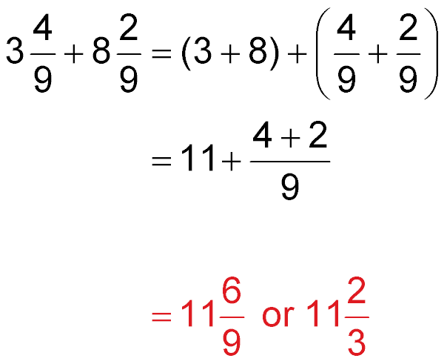
Example 2
Add Mixed Numbers
Add the whole numbers and fractions separately.
Add the numerators.
Simplify.
Answer:

Slide 18

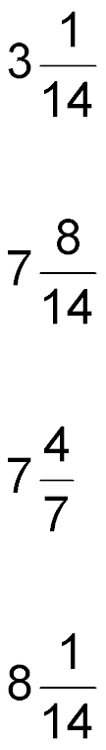
Example 2
A.
B.
C.
D.

Slide 19
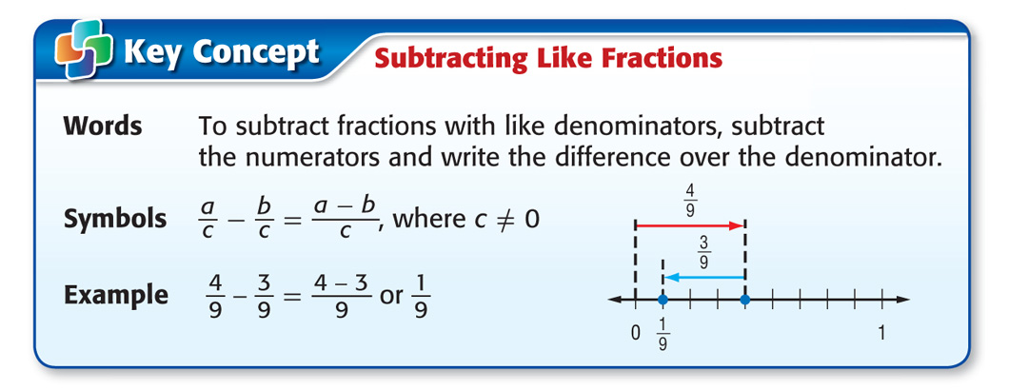
Concept

Slide 20
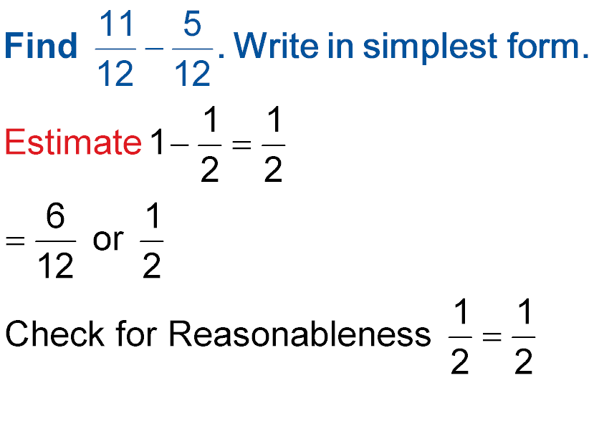
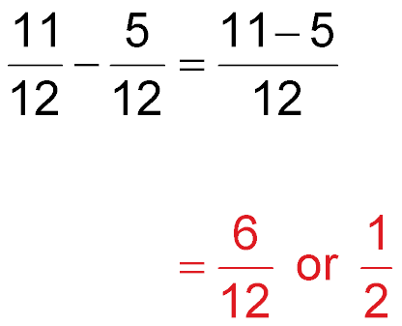
Example 3
Subtract Fractions
The denominators are the same. Subtract the numerators.
Simplify.
Answer:
Check for Reasonableness
✓

Slide 21


Example 3
A.
B.
C.
D.

Slide 22
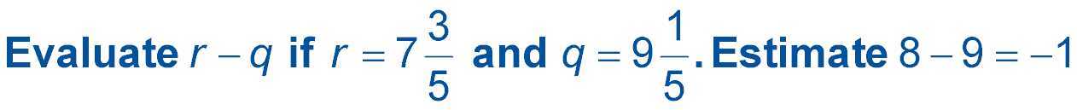
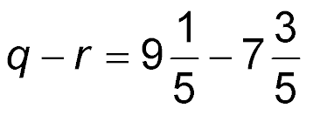
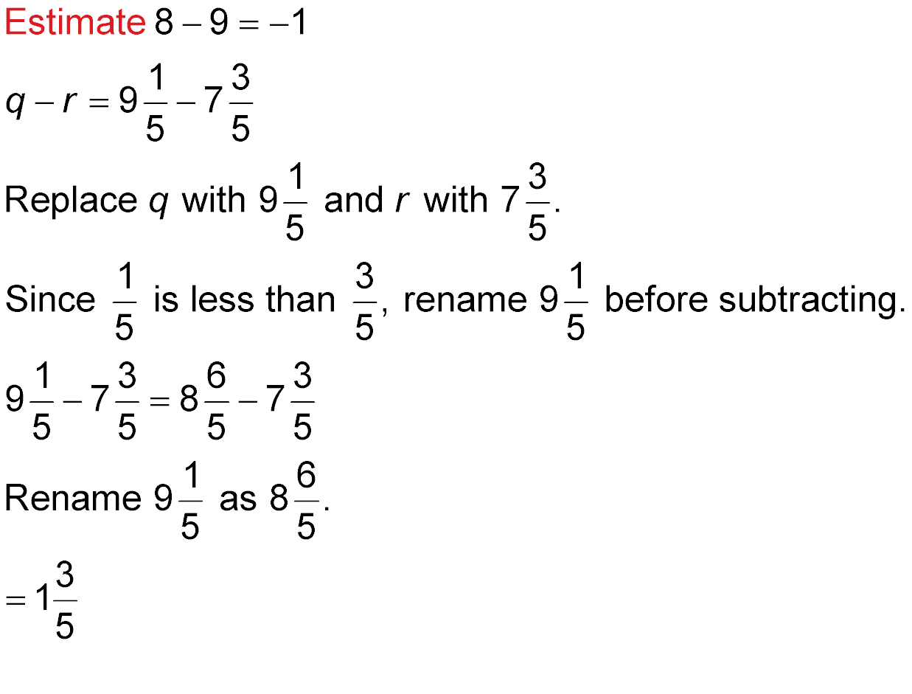
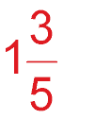
Example 4
Subtract Mixed Numbers with Regrouping
Subtract the whole numbers and then the fractions.
Answer:

Slide 23
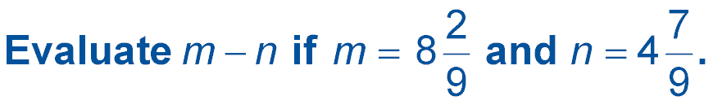
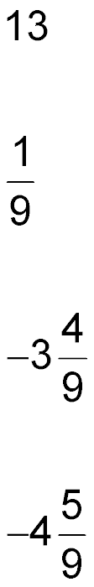

Example 4
A.
B.
C.
D.

Slide 24
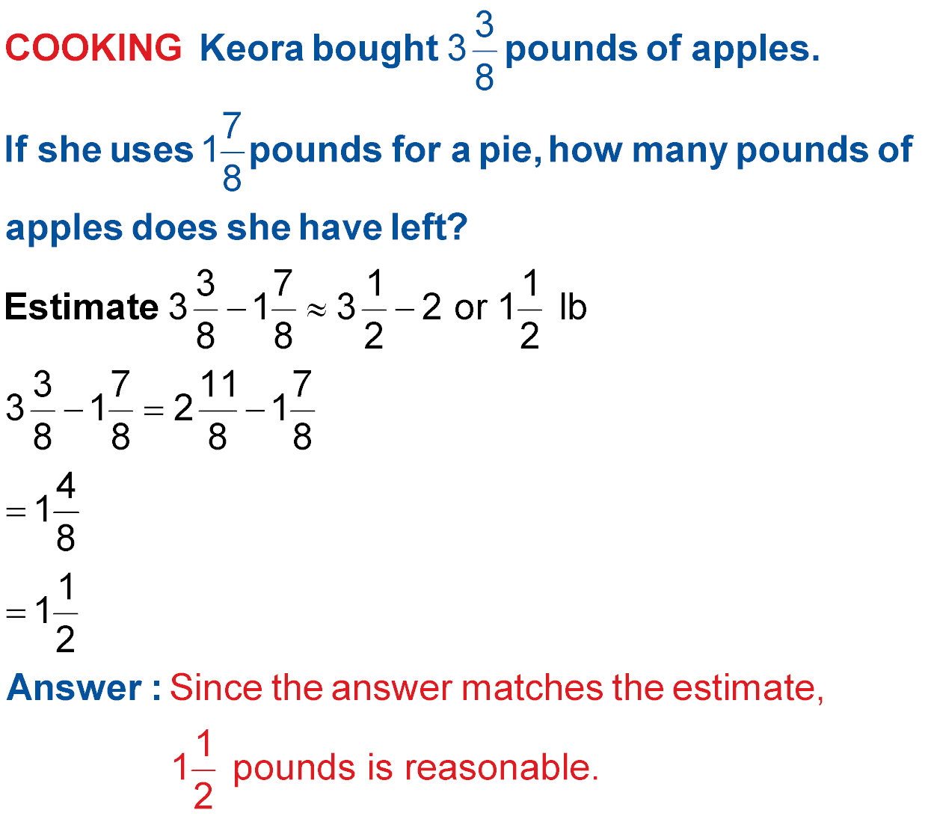
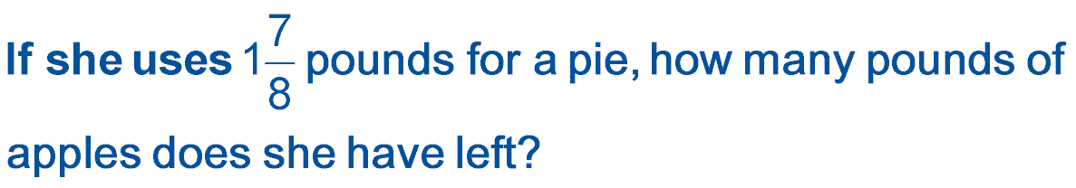
Example 5
Subtract Mixed Numbers
Understand You need to know how many pounds of apples she has left.
Plan Subtract the apples used from the total number of apples.
Estimate

Slide 25

Example 5
Subtract Mixed Numbers
Solve
Rename.
Subtract the whole numbers and then the fractions.
Simplify.

Slide 26
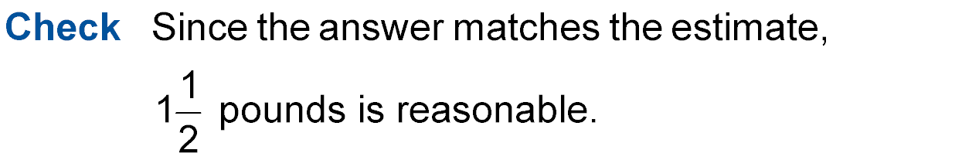
Example 5
Subtract Mixed Numbers

Slide 27
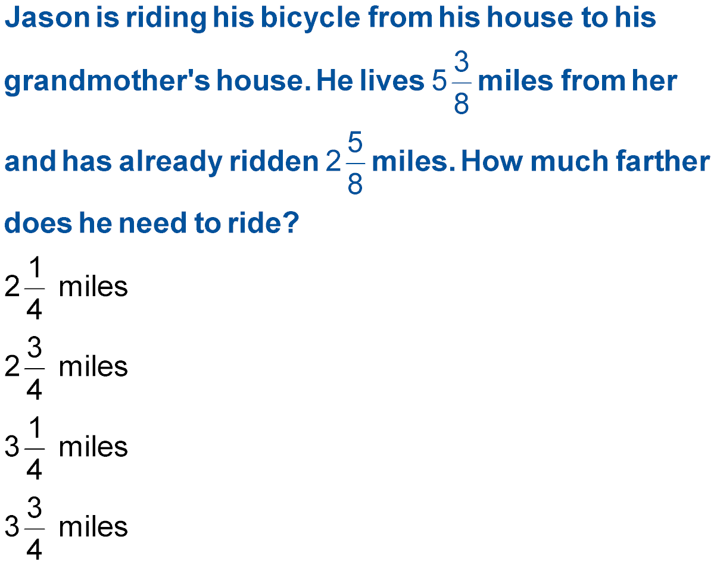
Example 5
A. B.
C. D.

Slide 28

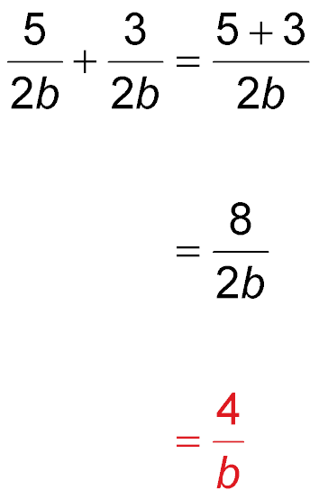
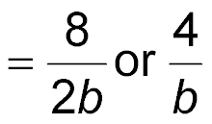
Example 6
Add or Subtract Algebraic Fractions
The denominators are the same. Add the numerators.
Simplify.
Answer:

Slide 29


Example 6
A.
B.
C.
D.

Slide 30
End of the Lesson

